Slide 2
SERIALIZATION AND DESERIALIZATION

Slide 3
Objective
Serialization
Use of Serialization
Serialization Process
Marking an object for Serialization
Serializable and NonSerialized attributes
Object Graph
Different types of Serialization
Support Provided by .NET Framework for Serialization
Binary serialization and de-serialization
SOAP serialization and de-serialization
XML serialization and de-serialization

Slide 4
What is Serialization?
Serialization is the process of converting an object into a stream of bytes in order to store the object or transmit it to memory, a database, or a file.
Its main purpose is to save the state of an object in order to be able to recreate it when needed.
The reverse process is called deserialization.
Together, these processes allow data to be easily stored and transferred.
Serialization Scenarios:
Persistence
Store and retrieve a graph of objects to and from a file
Remoting
Pass by value arguments that are transmitted between processes
Notes:
Note:
Use of Serialization:
Serialization allows the developer to save the state of an object and recreate it as needed, providing storage of objects as well as data exchange.
Through serialization, a developer can perform actions like sending the object to a remote application by means of a Web Service, passing an object from one domain to another, passing an object through a firewall as an XML string, or maintaining security or user-specific information across applications.

Slide 5
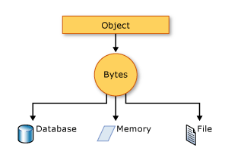
Serialization Process
The object is serialized to a stream, which carries not just the data, but information about the object's type, such as its version, culture, and assembly name.
From that stream, it can be stored in a database, a file, or memory.

Slide 6
Making an object Serializable
To serialize an object, you need
Object: Object of a class to be serialized,
Stream: A stream to contain the serialized object, and
Formatter. System.Runtime.Serialization namespaces contains the classes necessary for serializing and de-serializing objects.
Notes:
Note:
Classes Used by the Default Serialization Process
ObjectIDGenerator – generates IDs for objects
ObjectManager – tracks objects as they are being deserialized
Examples of Classes Used with Serialized Streams
FileStream, MemoryStream, NetworkStream

Slide 7
Marking Class for Serialization: SerializableAttribute and NonSerialized Attribute
Apply the SerializableAttribute attribute to a type to indicate that instances of this type can be serialized.
A SerializationException exception is thrown if you attempt to serialize but the type does not have the SerializableAttribute attribute.
If you do not want a field within your class to be serializable, apply the NonSerializedAttribute attribute.
If a field of a serializable type contains a pointer, a handle, or some other data structure that is specific to a particular environment, and the field cannot be meaningfully reconstituted in a different environment, then you may want to make it non-serializable.

Slide 8
Object Graph
Radio
Maruti
Car
If you want to serialize an object of a class which is linked with some other classes using “IS-A” or “HAS-A” relationship, then those classes has to be marked with [Serializable] attribute.
All the entities together form an object graph, now.
HAS - A
HAS - A
IS - A
Notes:
Consider, Car class has an object of Radio class, which available to derived classes of Car class too.
Maruti class is derived from Car class
So, Car and Maruti classes are bound through “IS-A” relationship.
Since, Maruti is derived from Car class, then Maruti class also posses the object of Radio class.
So, Car and Maruti class, both, is bound with Radio class with “HAS-A” relationship.
So, Car, Maruti and Radio class objects form an object graph.
If, you want to serialize an object of Maruti class, then Car as well as Radio class, both have to be marked with [Serializable] attribute.
Otherwise, Maruti class members will be serialized, but not the members of other two classes.

Slide 9
.NET Framework Serialization and Formatters
The .NET Framework features three serialization techniques:
Binary Serialization
SOAP Serialization
XML Serialization
Formatter is the one which decides which format will be used to serialized the object and writes or reads data in that format to the output or input streams
Depending on different serialization techniques, there are three types of formatters
Binary Formatter
SOAP Formatter
XML Formatter

Slide 10
Classes Supplied by .NET Framework class library
Serialization Technique | Formatter | BCL Class | Namespace
Binary Serialization | Binary Formatter | BinaryFormatter | System.Runtime.Serialization.Formatters.Binary
SOAP Serialization | SOAP Formatter | SoapFormatter | System.Runtime.Serialization.Formatters.Soap
XML Serialization | XML Formatter | XmlSerializer | System.Xml.Serialization
Notes:
You have to add a reference to System.Runtime.Serialization.Formatters.Soap.dll (version 2.0) in your application to avail SoapFormatter class for Soap Serialization
In other serialization cases, there is no need to add any reference to any libraries.

Slide 11
Binary Serialization and Deserialization
Serialization
During this process, the public and private fields of the object and the name of the class as well as assembly metadata, are converted to a stream of bytes
The bytes are then written to a data stream
Deserailization
When the object is subsequently deserialized, an exact clone of the original object is created, containing the data
Notes:
1. All types of fields are serialized, even if it is private
2. Assembly metadata of the containing assembly is also serialized
3. Class information is serialized
4. If the class is part of an object graph, then information about all the classes, part of that object graph will be serialized, along with their containing assembly metadata
5. Data of the fields will be serialized being associated with the field name
6. Object of class with any (public or internal) access specifier is only serialized

Slide 12
SOAP Serialzation
Serialization
During this process, the public and private fields of the object and the name of the class as well as assembly metadata, are converted to a stream of data in soap format
Deserailization
When the object is subsequently deserialized, an exact clone of the original object is created based on the serialized data, containing the field data
Notes:
1. All types of fields are serialized, even if it is private
2. Assembly metadata of the containing assembly is also serialized
3. Class information is serialized
4. If the class is part of an object graph, then information about all the classes, part of that object graph will be serialized, along with their containing assembly metadata
5. Data of the fields will be serialized being associated with the field name
6. Object of class with any (public or internal) access specifier is only serialized

Slide 13
Xml Serialization
Serialization
During this process, the public fields and properties, or the return value of any method of the object along with the name of the class are converted into xml format
Deserailization
When the object is subsequently deserialized, an exact clone of the original object is created based on the serialized data, containing the field data
Notes:
All types of fields are not serialized. XML serialization converts (serializes) only the public fields and properties of an object, or the parameters and return values of methods, into an XML stream that conforms to a specific XML Schema definition language (XSD) document
XML serialization results in strongly typed classes with public properties and fields that are converted to a serial format (in this case, XML) for storage or transport
Assembly metadata of the containing assembly is not serialized
Field data gets serialized being associated with the property name or public field name
Object of class with ‘public’ access specifier is only serialized
If the class is part of an object graph, then information about all the classes, part of that object graph will be serialized.
The following items can be serialized using the XMLSerializable class:
Public read/write properties and fields of public classes
Classes that implement ICollection or IEnumerable (Note that only collections are serialized, not public properties)
XmlElement objects
XmlNode objects
DataSet objects

Slide 14
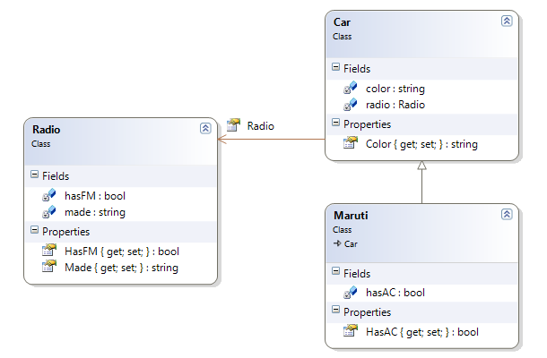
Example of Different Types of Serialization
Three classes have been used for serialization and de-serialization of objects, part of an object graph: Radio, Car and Maruti
Car class has-a Radio
Maruti is a derived class of Car class
Since Maruti is derived from Car, so Maruti class has-a Radio, too

Slide 15
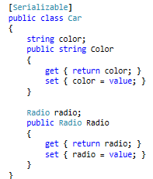
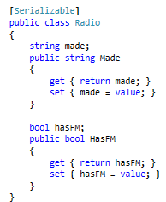
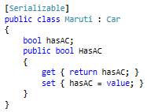
Example of Different Types of Serialization
Class Code
HAS-A
IS-A

Slide 16
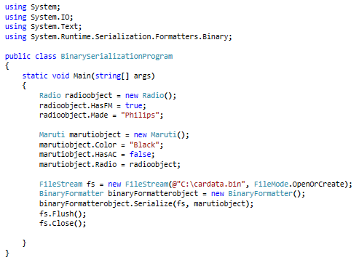
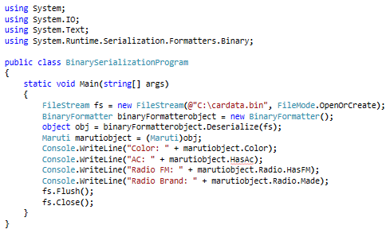
Example of Different Types of Serialization: Binary Serialization and De-Serialization
Binary Serialization
Binary De-serialization
Notes:
Faculty Note:
Explain the program

Slide 17
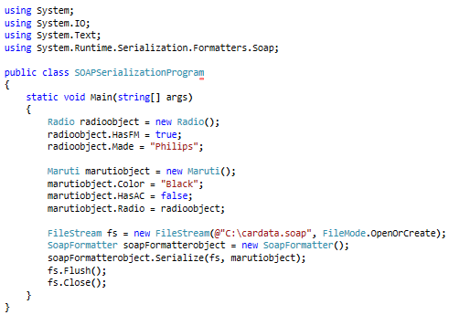
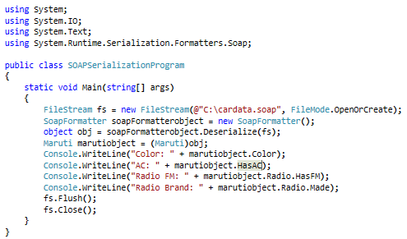
Example of Different Types of Serialization: SOAP Serialization and De-Serialization
SOAP Serialization
SOAP De-serialization
Notes:
Faculty Note:
Explain the program
Note:
You have to add a reference to System.Runtime.Serialization.Formatters.Soap.dll (version 2.0) in your application to avail SoapFormatter class for Soap Serialization

Slide 18
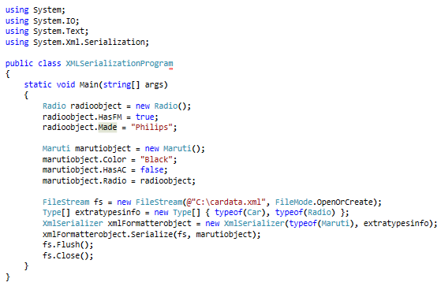
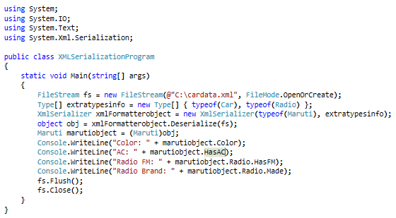
Example of Different Types of Serialization: XML Serialization and De-Serialization
XML Serialization
XML De-serialization
Notes:
Faculty Note:
Explain the program

Slide 19
Reference
For serialization and de-serializationin .NET, visit the following links:
http://msdn.microsoft.com/en-us/library/ms233843.aspx
http://www.codeproject.com/Articles/1789/Object-Serialization-using-C
http://www.codeproject.com/Tips/394133/XML-Serialization-and-Deserialization-in-Csharp
Notes:
Reference

